Slide 1
Embedding Accessibility into Code Reviews
Christina Adams – Sr. Digital Accessibility Engineer @ Siteimprove

Slide 2
Intentions
Share common code checks for code reviews
Understand we won’t find everything
Realize not everyone here codes, share in a common language
Describe user experiences for errors, the “why”
Transparency: I have way too many slides

Slide 3
Semantic HTML

Slide 4
Semantic Elements
Recommend changes!
Semantic elements priority
”Tricking” automated tests
<div tabindex=“0”>Submit</div>
<div role=“button” tabindex=“0”>Submit</div>
<div role=“list”>
<li>Listitem 1</li>
<li>Listitem 2</li>
<li>Listitem 3</li>
</div>

Slide 5
Form Element and Submit Buttons
<form>
…
<input type=“submit” value=“Submit the form”>
<button type=“submit”>Submit</button>
</form>

Slide 6
Associated Labels
<label for=“field1”>First Name</label>
<input id=“field1” type=“text”>
<label>First Name
<input type=“text”>
</label>

Slide 7
Fieldsets with legends
<fieldset>
<legend>Which option applies?</legend>
<label>
<input type=“radio”>Option 1
</label>
<label>
<input type=“radio”>Option 2
</label>
</fieldset>

Slide 8
ARIA

Slide 9
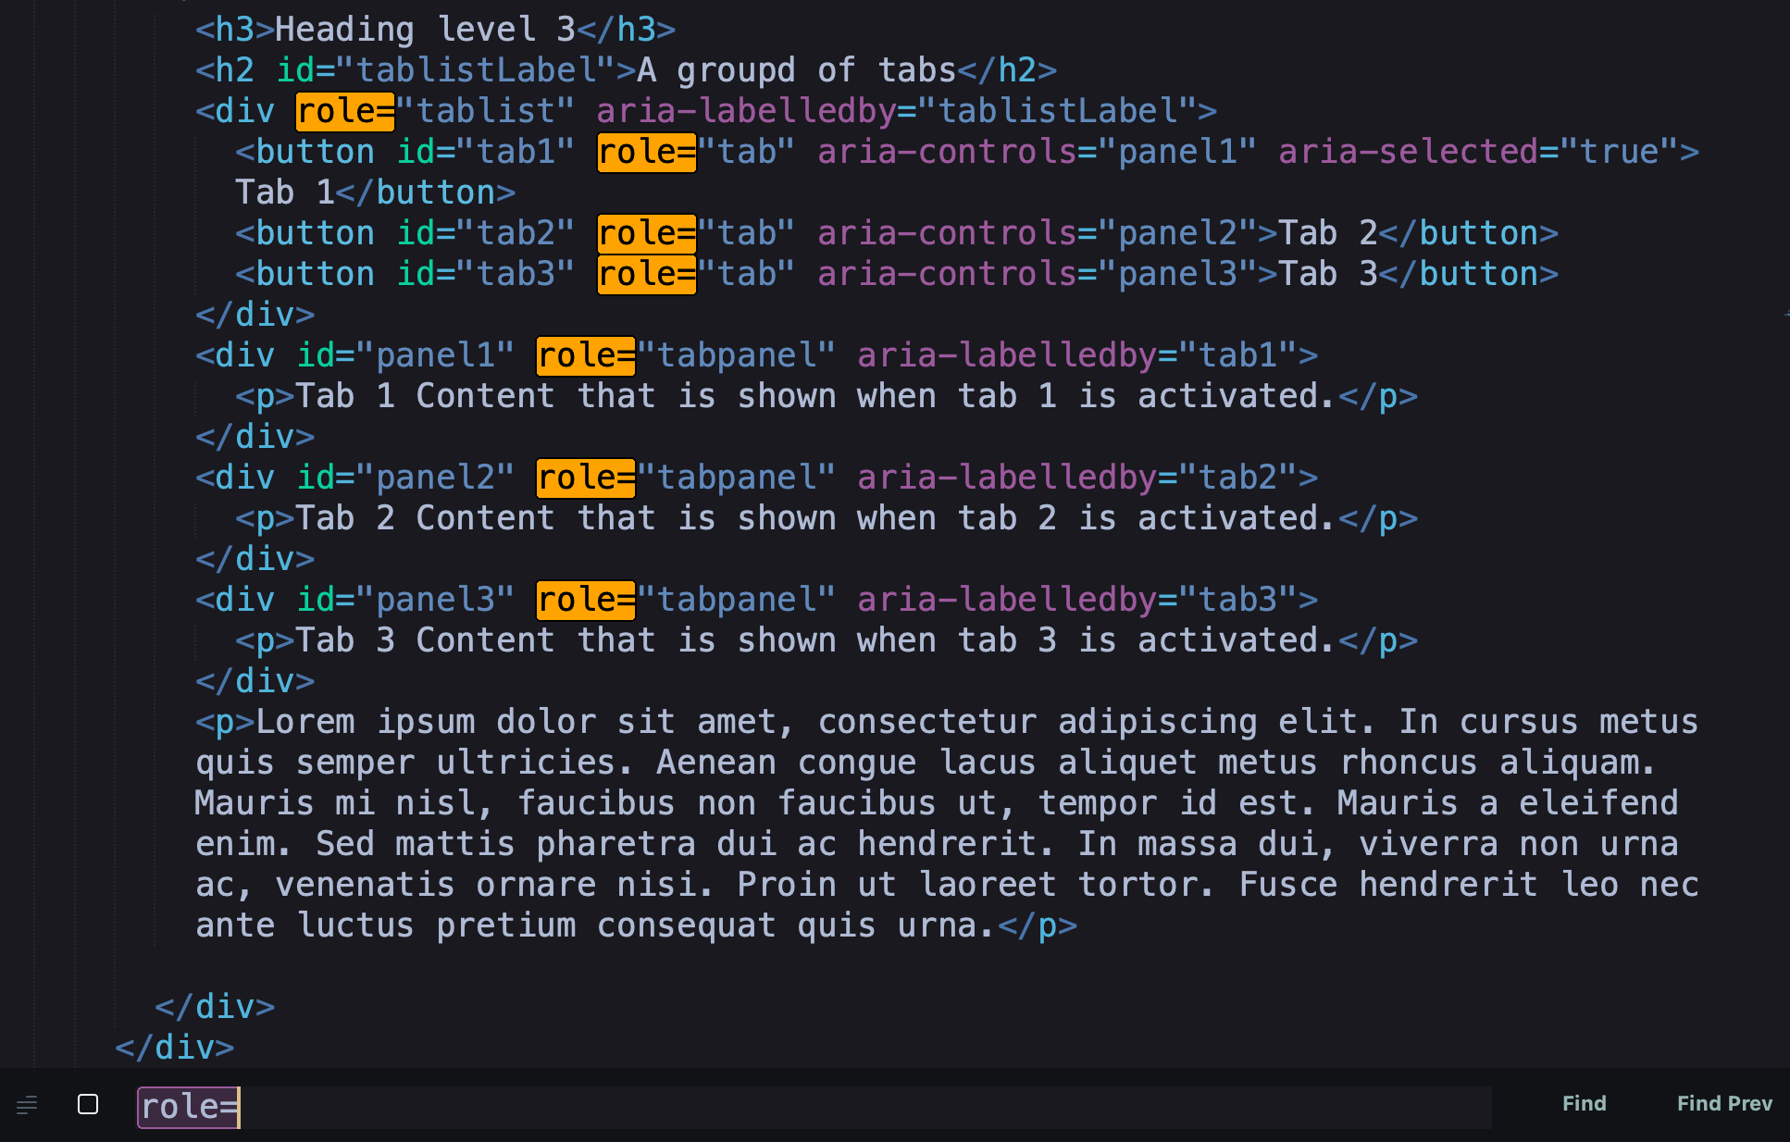
Search for role=

Slide 10
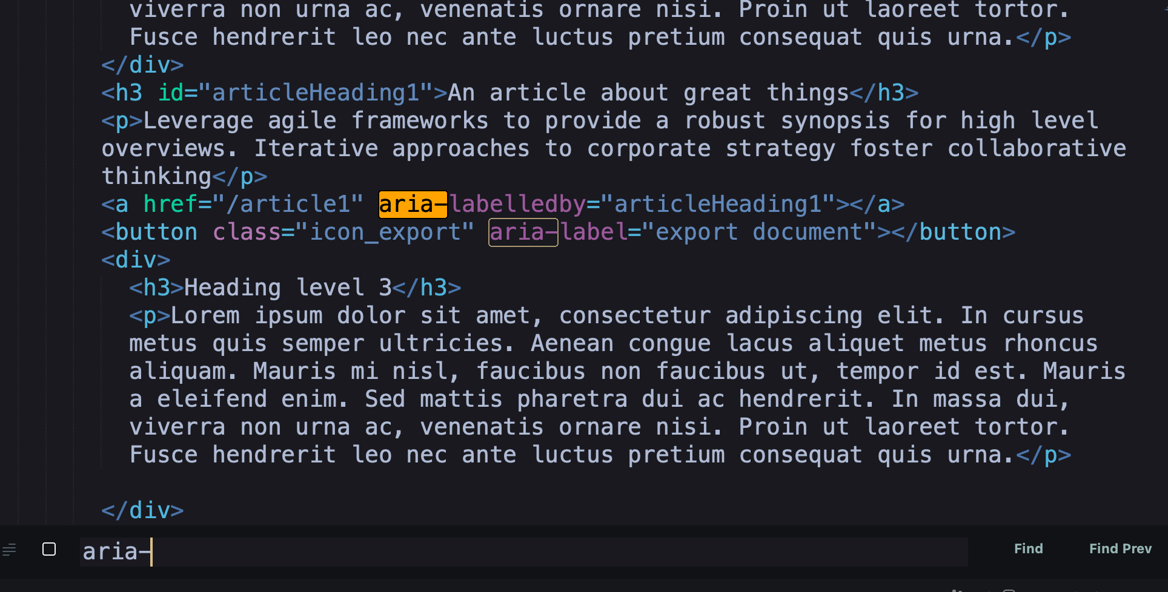
Search for aria-label and aria-labelledby

Slide 11
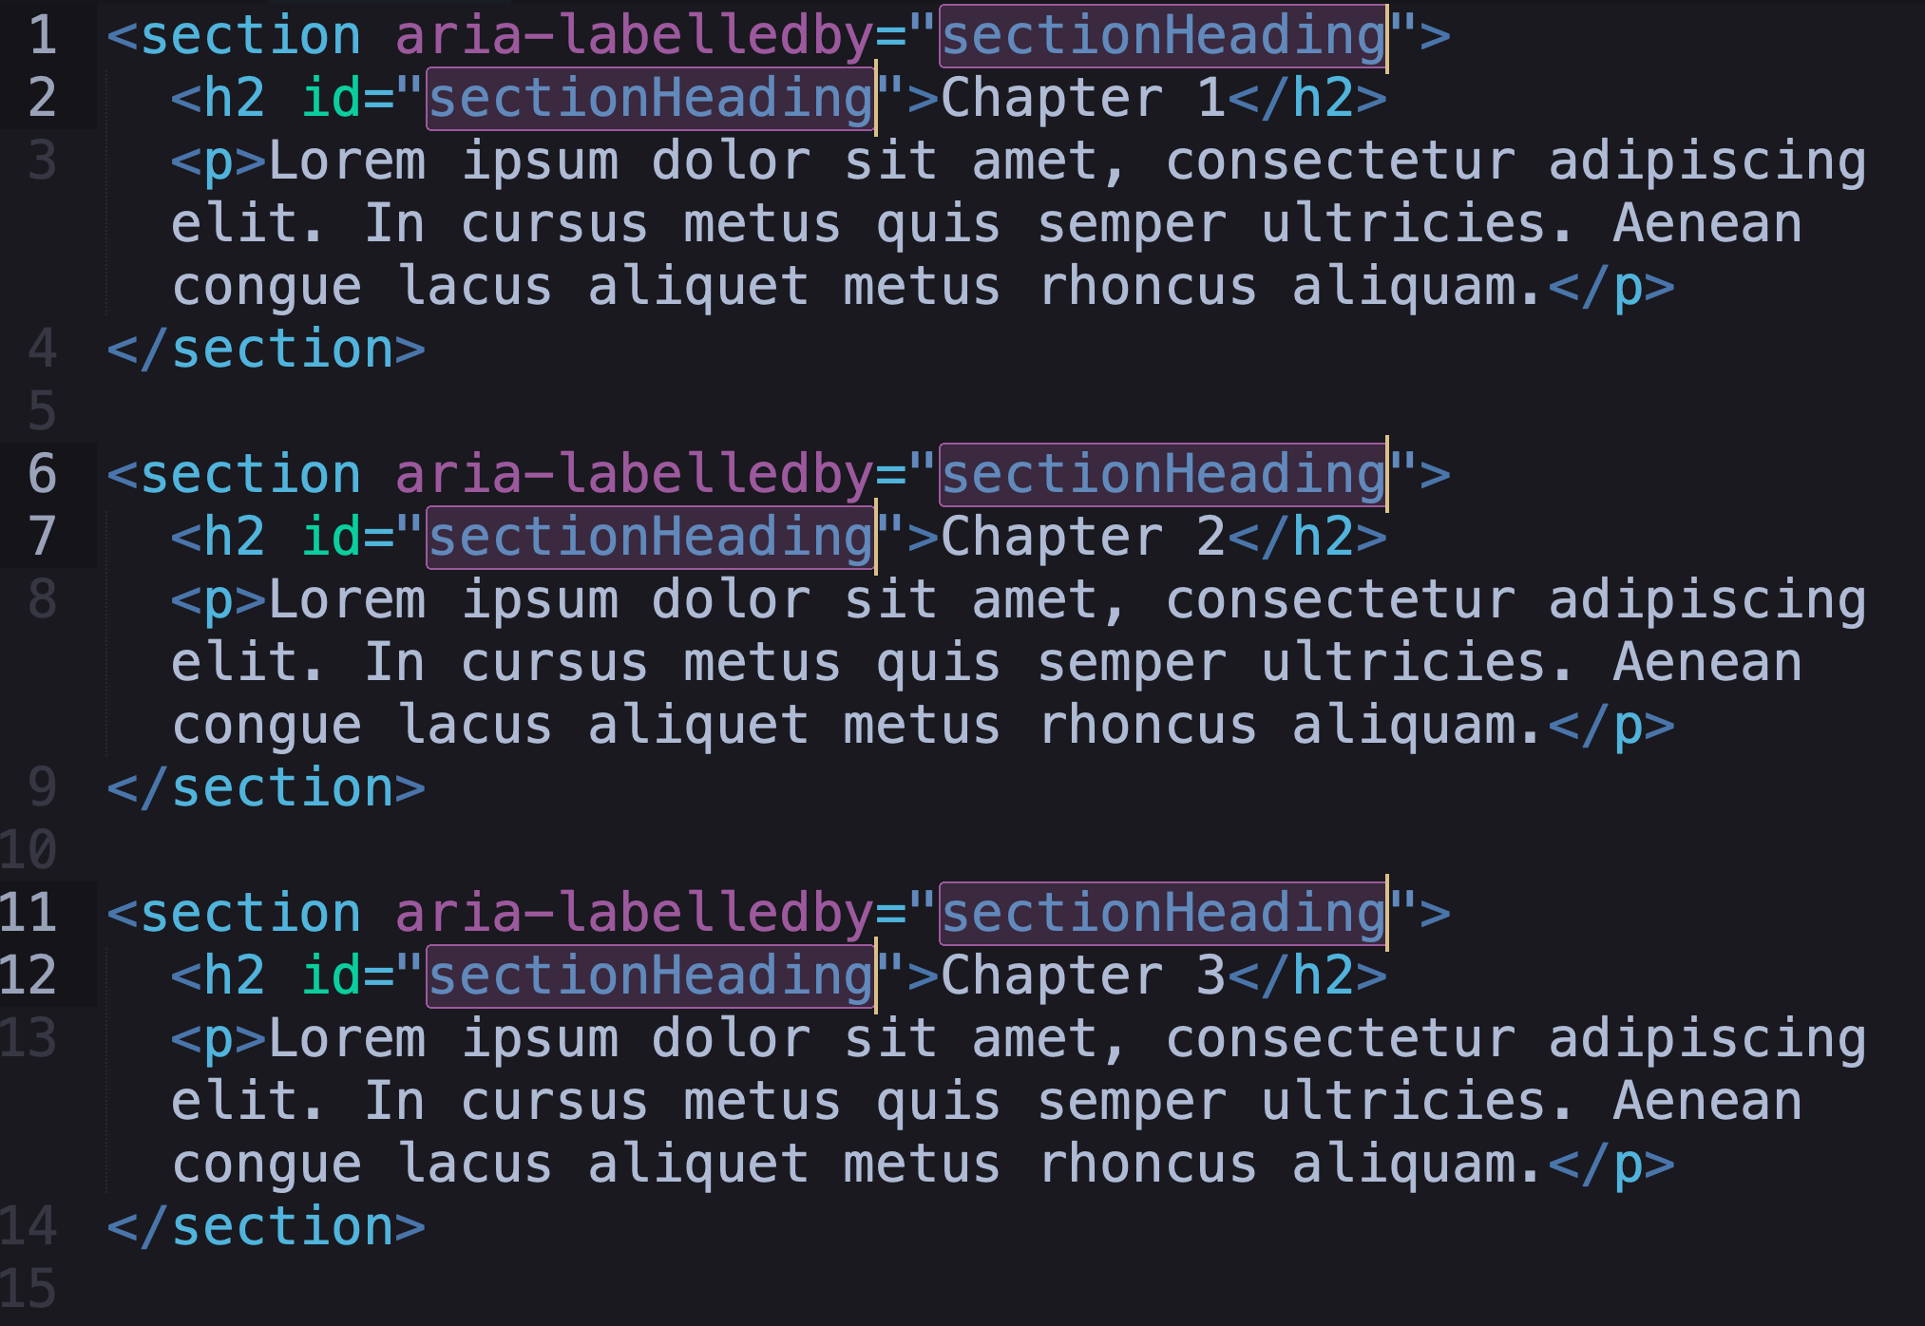
aria-labelledby and duplicate ID issues

Slide 12
aria-live and live roles
<div aria-live=“polite” aria-atomic=“true”>
<p>Search Results: 5</p>
</div>
Limited use
Including summary content
Correct type of notification
(status vs alert)
<div role=“status”>
<p>Search Results: 5</p>
</div>
<div role=“alert”>
<p>Error: Invalid email address</p>
</div>

Slide 13
Accessibility Tree

Slide 14
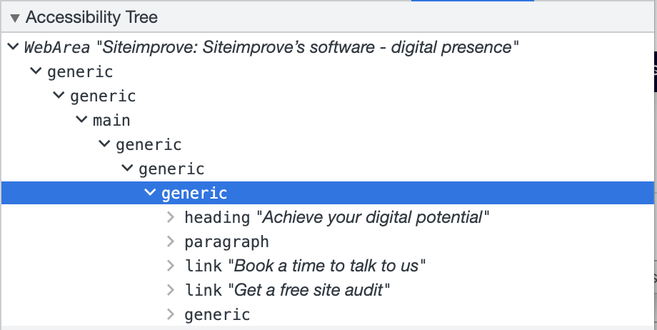
The Accessibility Tree
DOM structure at its core
Roles, states, properties, and accessible names
The basis of the API that assistive tech use

Slide 15
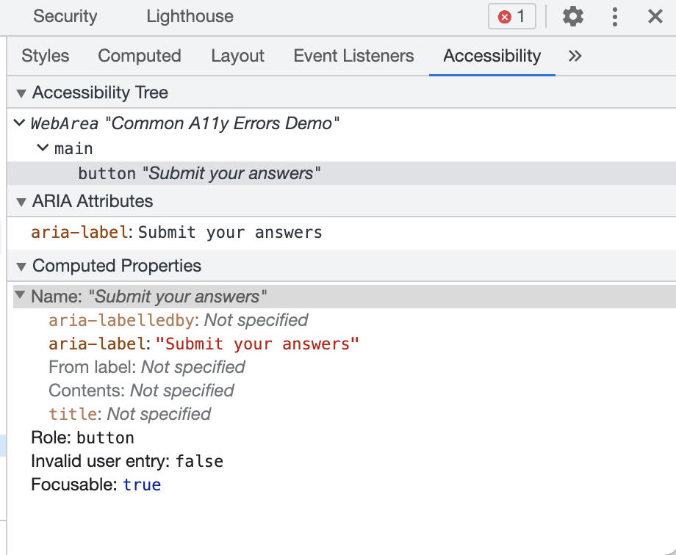
Accessible names
Native HTML
ARIA
<button>Submit your answers</button>
<button class=“icon-submit”
aria-label=“Submit your answers”></button>

Slide 16
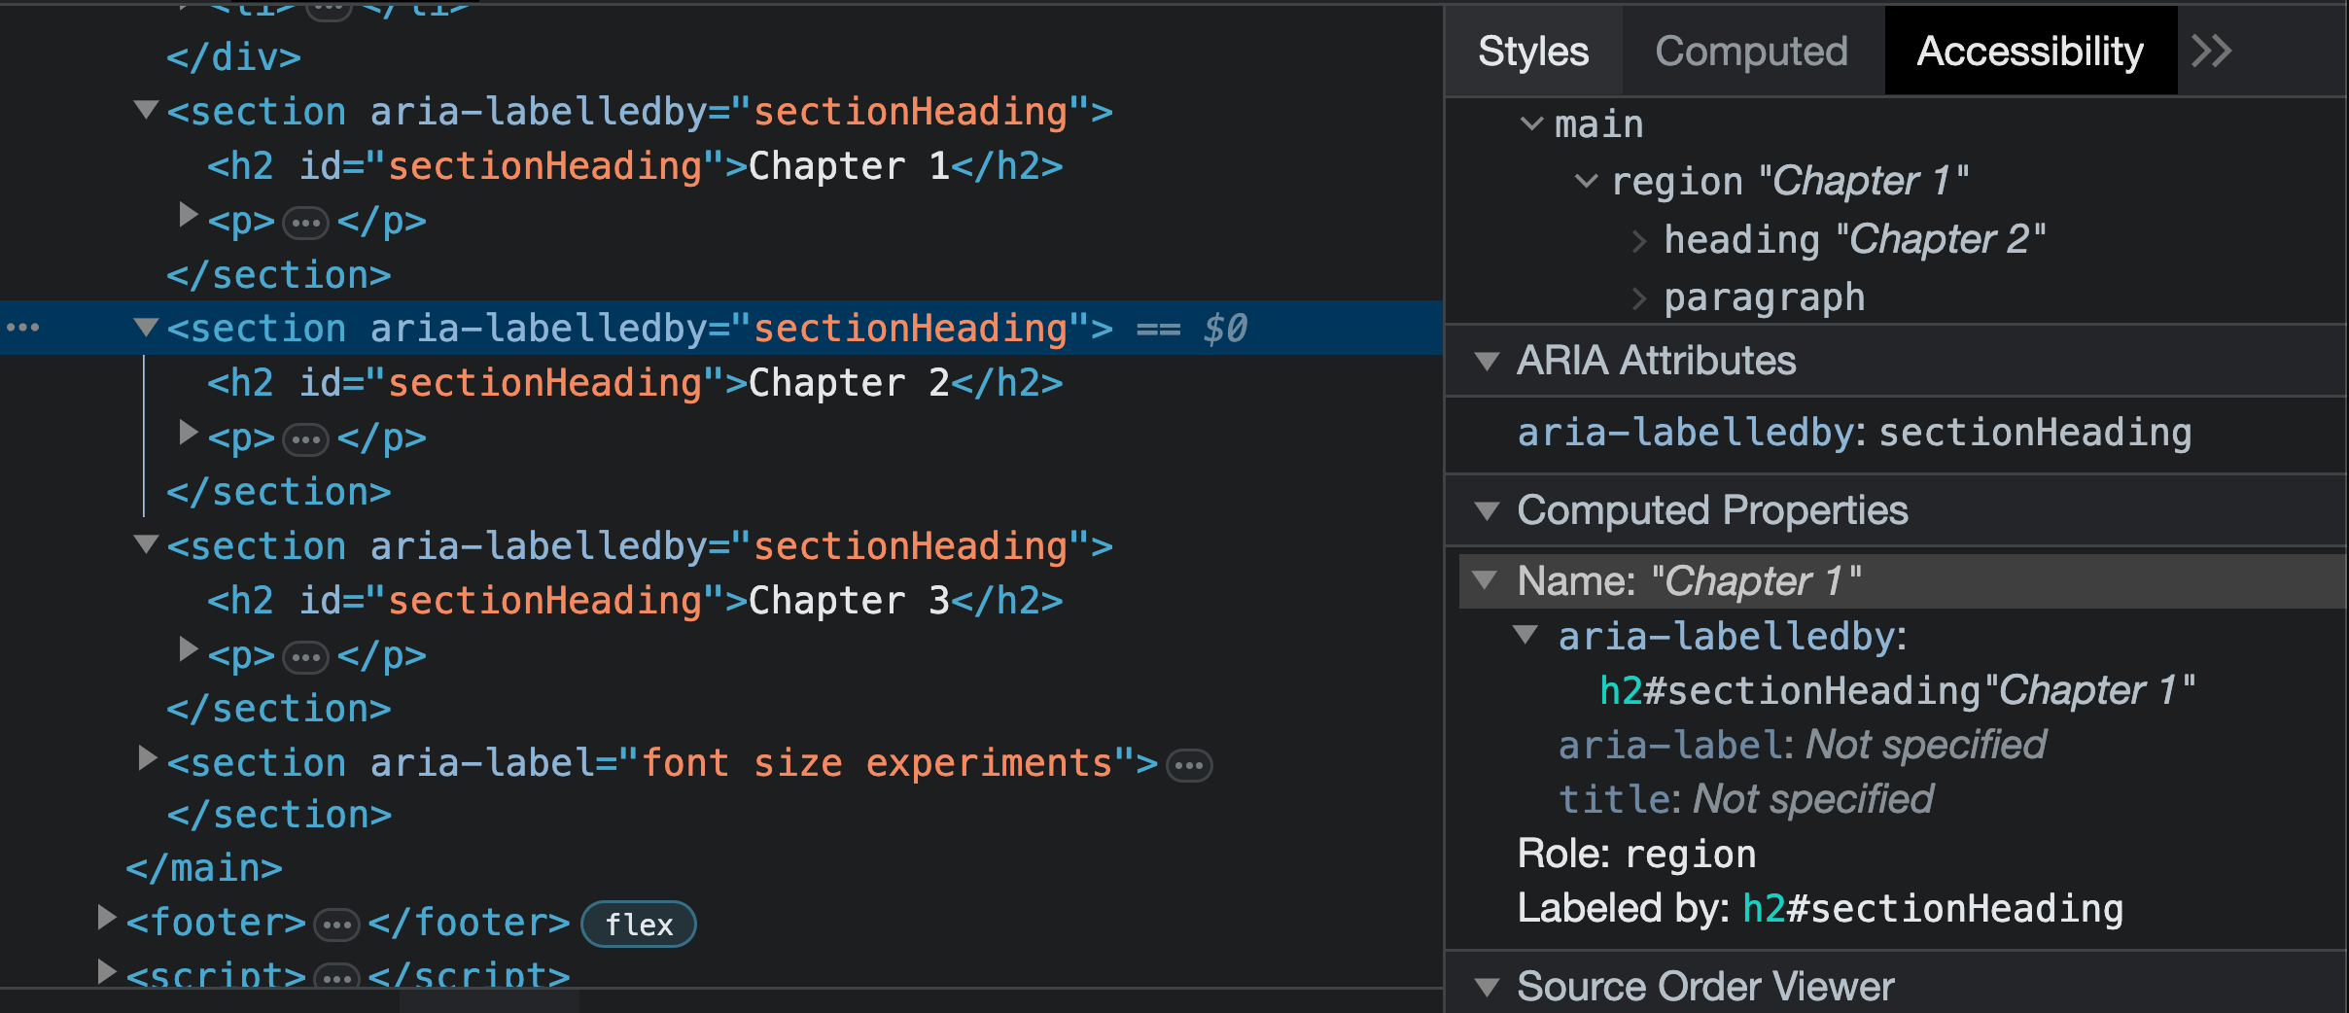
Duplicate ID example again
Chrome Dev Tools

Slide 17
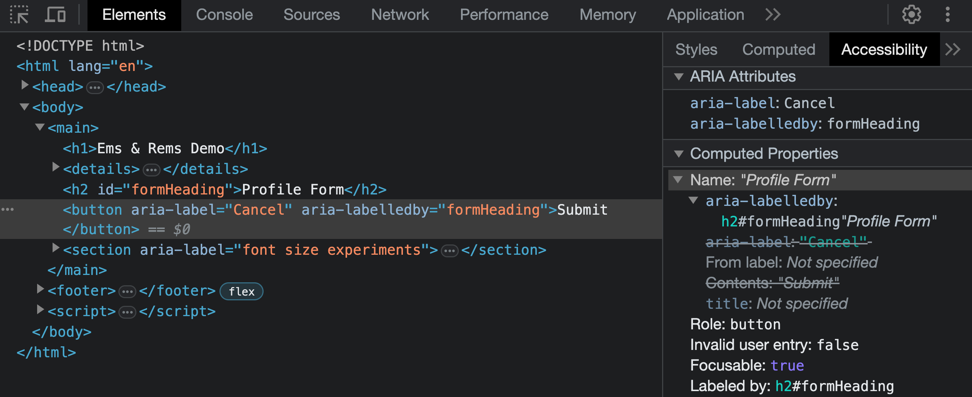
Accessible Name Calculation

Slide 18
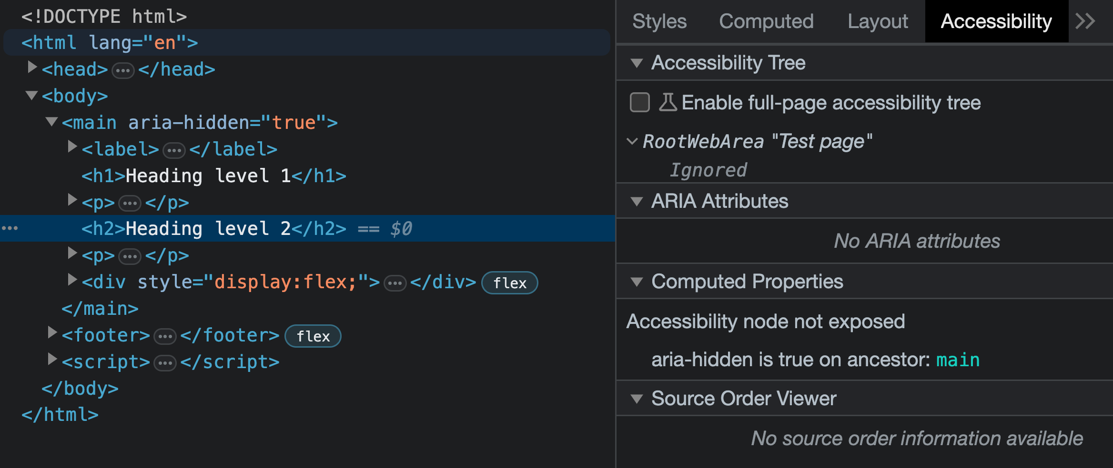
Ignored – not accessible

Slide 19
Keyboard Access

Slide 20
Keyboard access for all interactive elements
Use the keyboard to access all interactive elements

Slide 21
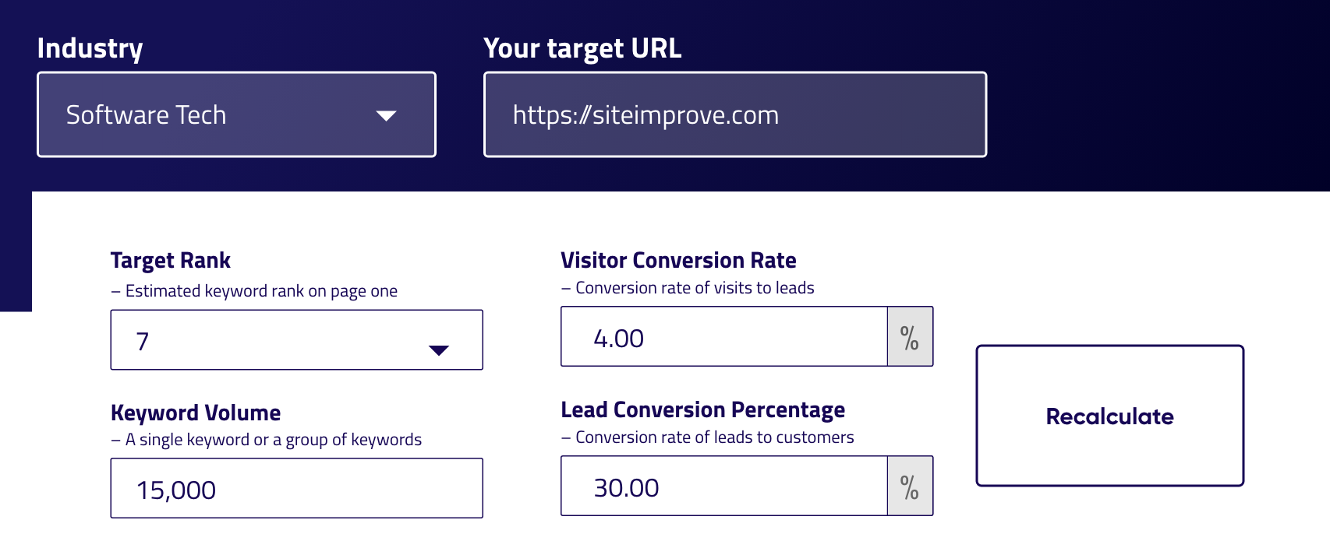
Alternative focus order diagram
Elements in a logical order

Slide 22
CSS float
<button style=“float:right;”>Button 1</button>
<button style=“float:right;”>Button 2</button>
Button 2
Button 1

Slide 23
CSS flex - order
<div style=“display:flex;”>
<div style=“order:3;”>Button 1</div>
<div style=“order:1;”>Button 2</div>
<div style=“order:2;”>Button 3</div>
</div>
display: flex;
Button 2
order: 1;
Button 3
order: 2;
Button 1
order: 3

Slide 24
CSS position: fixed, absolute, sticky
<body>
<main> ... </main>
<div style=“position:fixed; top:0; left:0;”>Notification banner</div>
</body>
Notification Banner

Slide 25
Thank you!
Christina Adams
linkedin.com/in/christina-adams-developer

